Slide 1

ATLAS Final Presentation
By: Ihor

Slide 2
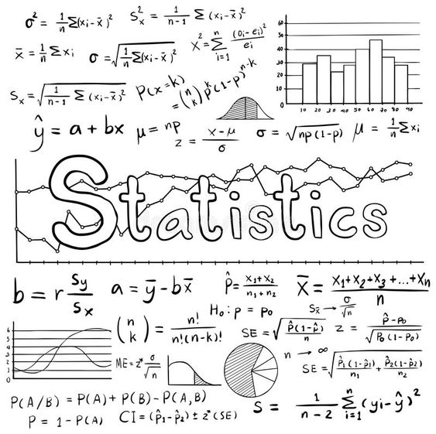

About Me
I’m Ihor
Statistics major
First time in ATLAS program
Documentation and training intern

Slide 3
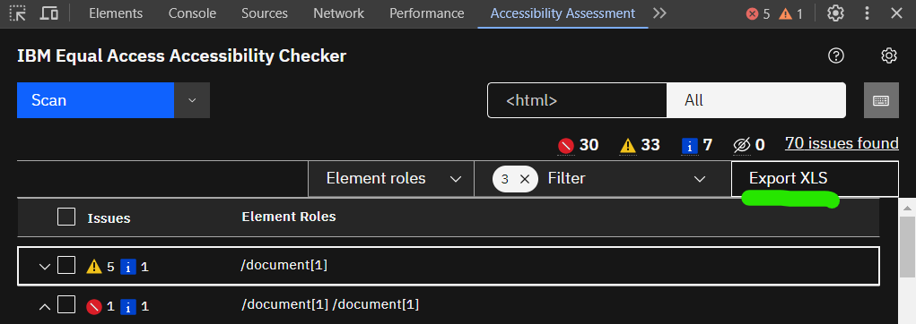
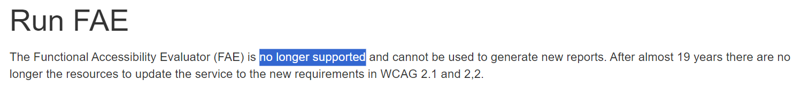
Project Motivation
Web accessibility is a huge priority
Old tool FAE discontinued
New replacement by IBM
Very bad at summarizing
Automated summary reports?

Slide 4
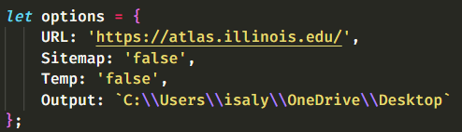
How It Works
Enter a URL, crawler navigates
Page gets processed, data extracted
Report is generated based on data

Slide 5
Demo: Remove Temp Folder

Slide 6
Demo: Sitemap

Slide 7



Goals and What I Learned
Goals:
Data Manipulation / Visualization
Improve at Programming
Communication Skills
What I Learned:
Advanced Automation
Asynchronous Programming
Polyglot Programming

Slide 8

Conclusion
Outcomes:
Created versatile, useful application
Gained professional expertise
Next Steps:
Host code on a server
Fix bugs

Slide 9
Thank You For Your Time

